Slide 1

Chicago Crime Prediction
Melissa Tobias, Natalie Pegues, Malaika Galvan, Daynise
Escudero, and Sirjana Yadav

Slide 2
Baseline models set a basic level of performance that more complex models should aim to exceed.
Background information of Chicago
Final conclusion and summary of the project
Introduction
Cleaning/
pre-processing
Baseline Model
Modeling
Final Thoughts
Crucial steps in preparing raw data for analysis and modeling
The process of creating a blueprint or representation of how data is organized, structured, and related

Slide 3

Background
Chicago has long faced challenges with public safety, particularly in specific neighborhoods. Their violent crime rate is around 540 per 100,000 people and is one of the top 20 cities in the US. with the highest crime rates. Understanding patterns in criminal activity like what types of crime occur most frequently and where they are concentrated is essential for law enforcement and community leaders.
The dataset includes over five years of reported crime data from 2012 to 2017 in the city of Chicago. Providing detailed information such as the type of crime, location, time, arrest status, and more. By analyzing this data, we are aiming to identify high risk areas and trends, offering insights that could inform and create future crime prevention strategies.

Slide 4
Objective & research questions
Our project focuses on using classification and other techniques to answer the following questions:
Can we predict whether an arrest will occur for a reported crime in Chicago?
How frequently do arrest occur for reported crimes?
Can historical data help inform police decision making?
How can we use past patterns to support smarter deployment and improve justice outcomes?

Slide 5
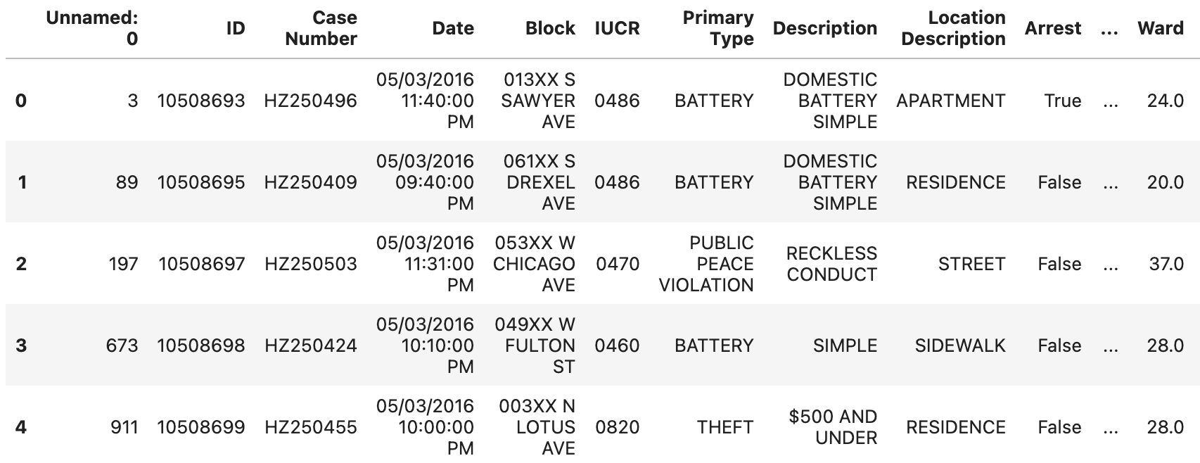
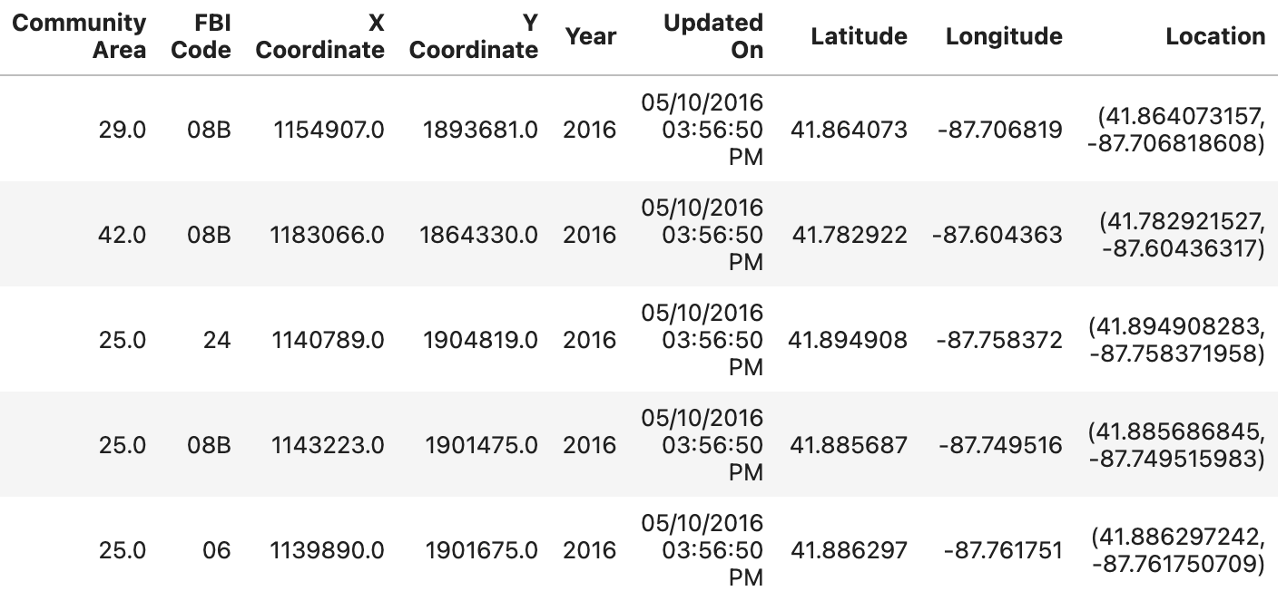
Notes:
Head of OG dataset

Slide 6
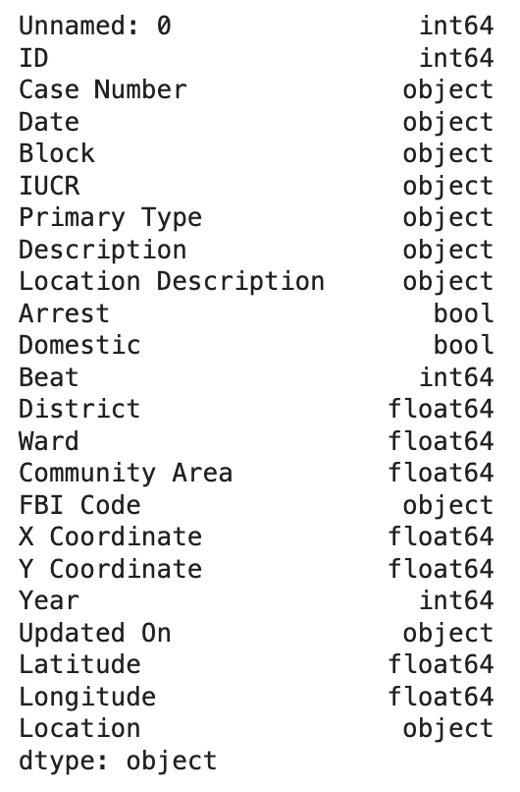
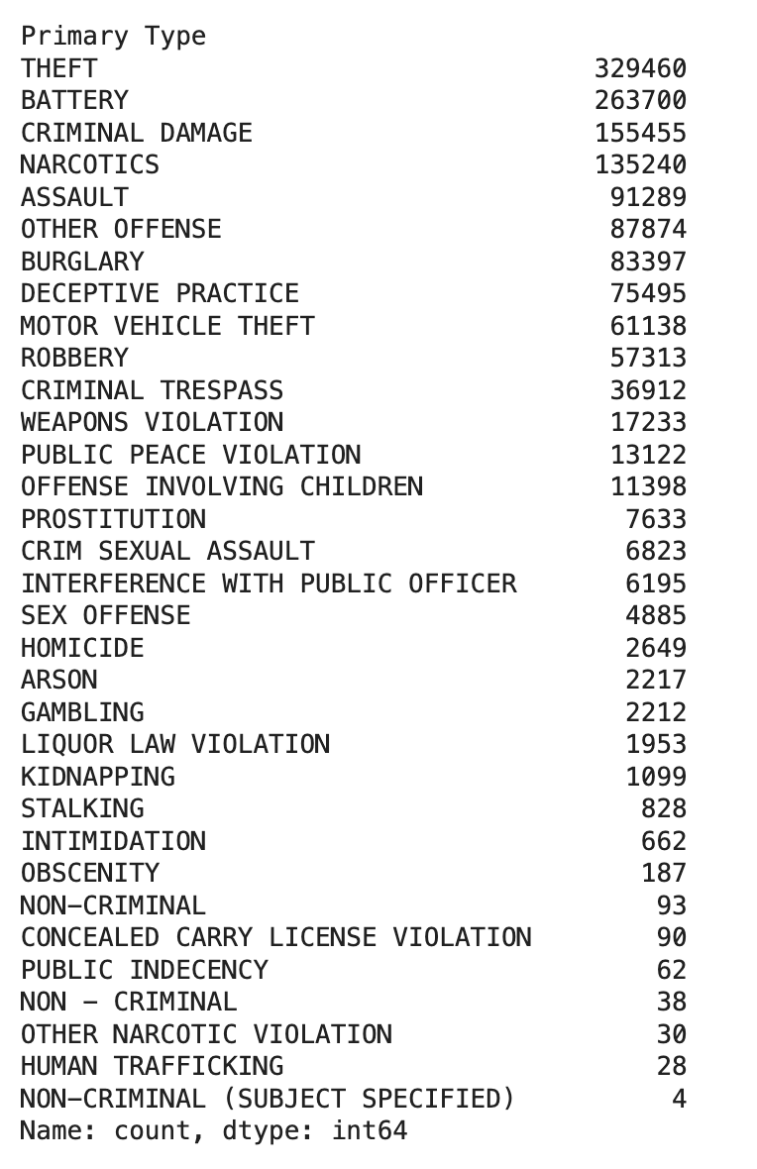
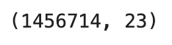
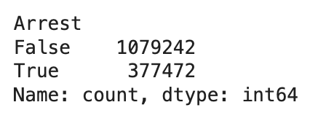
Notes:
Types of each column, data size, arrest, location, and crime type stats

Slide 7
Methodology
Problem Type
Binary classification task: Predict whether a crime will result in an arrest
Tools & Libraries
Pandas, NumPy – Data manipulation and cleaning
Scikit-learn – Modeling, evaluation, and preprocessing
Matplotlib, Seaborn – Visualizations
XGBoost – Advanced tree-based classification
Models Used
Logistic Regression - Interpretable baseline model, and good for linearly separable classes
Decision Tree - Simple non-linear classifier and helps visualize decision paths
XGBoost Classifier - Handles class imbalance, overfitting and is a strong performance on structured/tabular data
Random forest - To handle large data and class imbalance better

Slide 8
Exploratory Data Analysis
Feature Categorization, grouped them into:
Categorical: Crime type, arrest status, location description
Numerical: District, Beat, Ward, Community Area
Date/Time: Reported date, last update
Location: Latitude, Longitude
Initial Insights
Theft and battery are the most common crimes.
Most crimes are not domestic and don’t result in an arrest.
Certain community areas consistently show higher crime counts.
Visual Exploration
Used bar plots to visualize categorical feature frequencies.
Noted clutter in visuals due to long category names, future visual improvements planned.

Slide 9
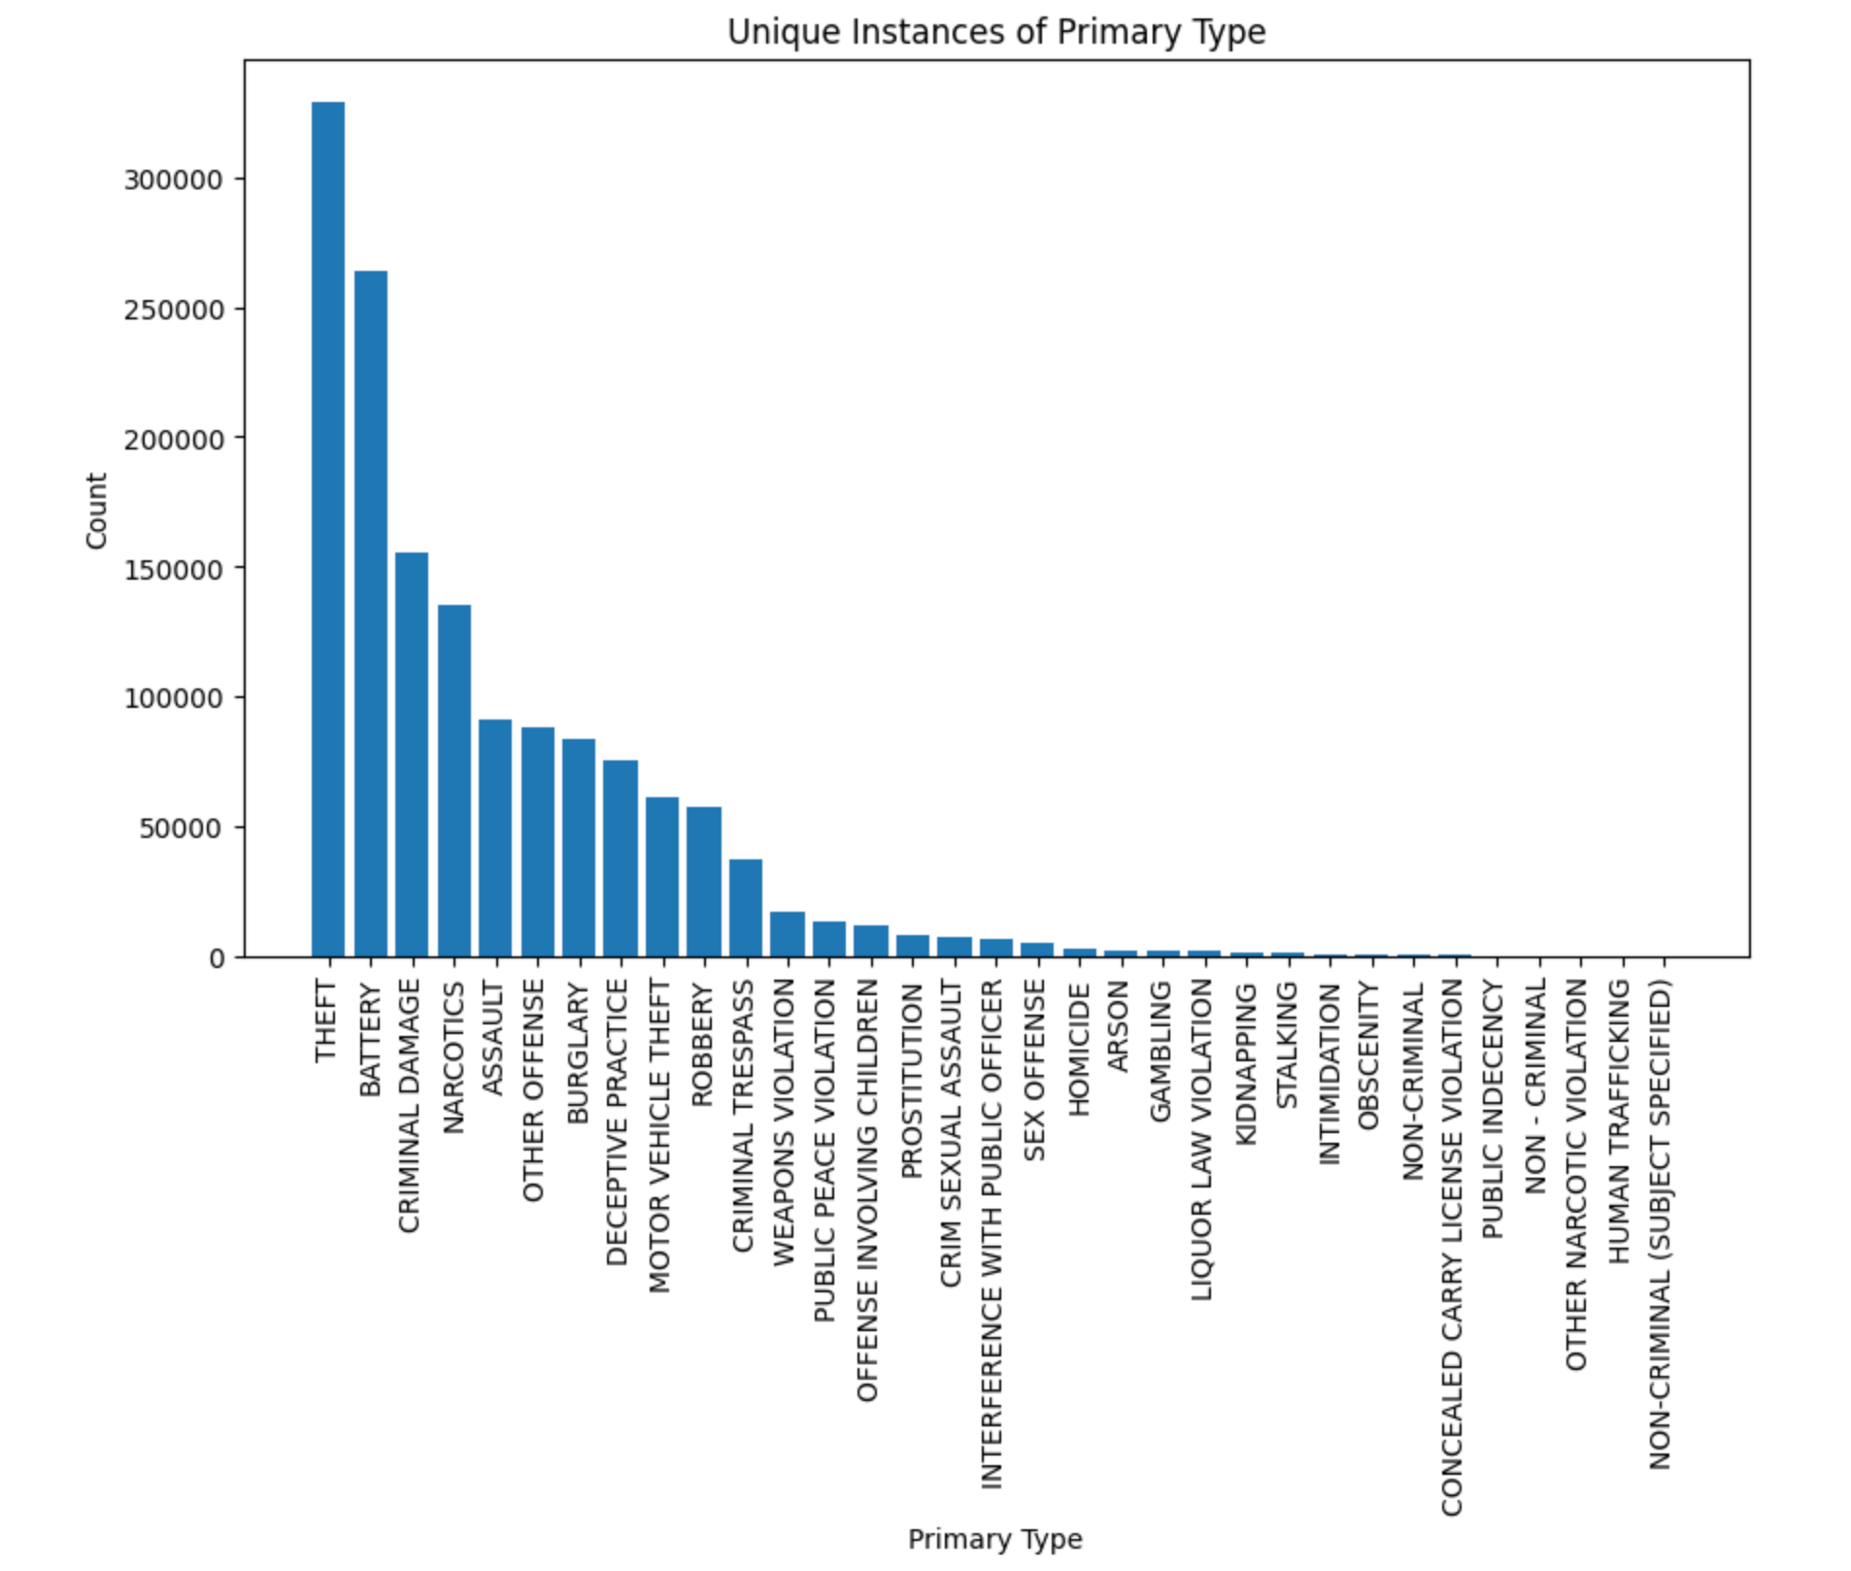
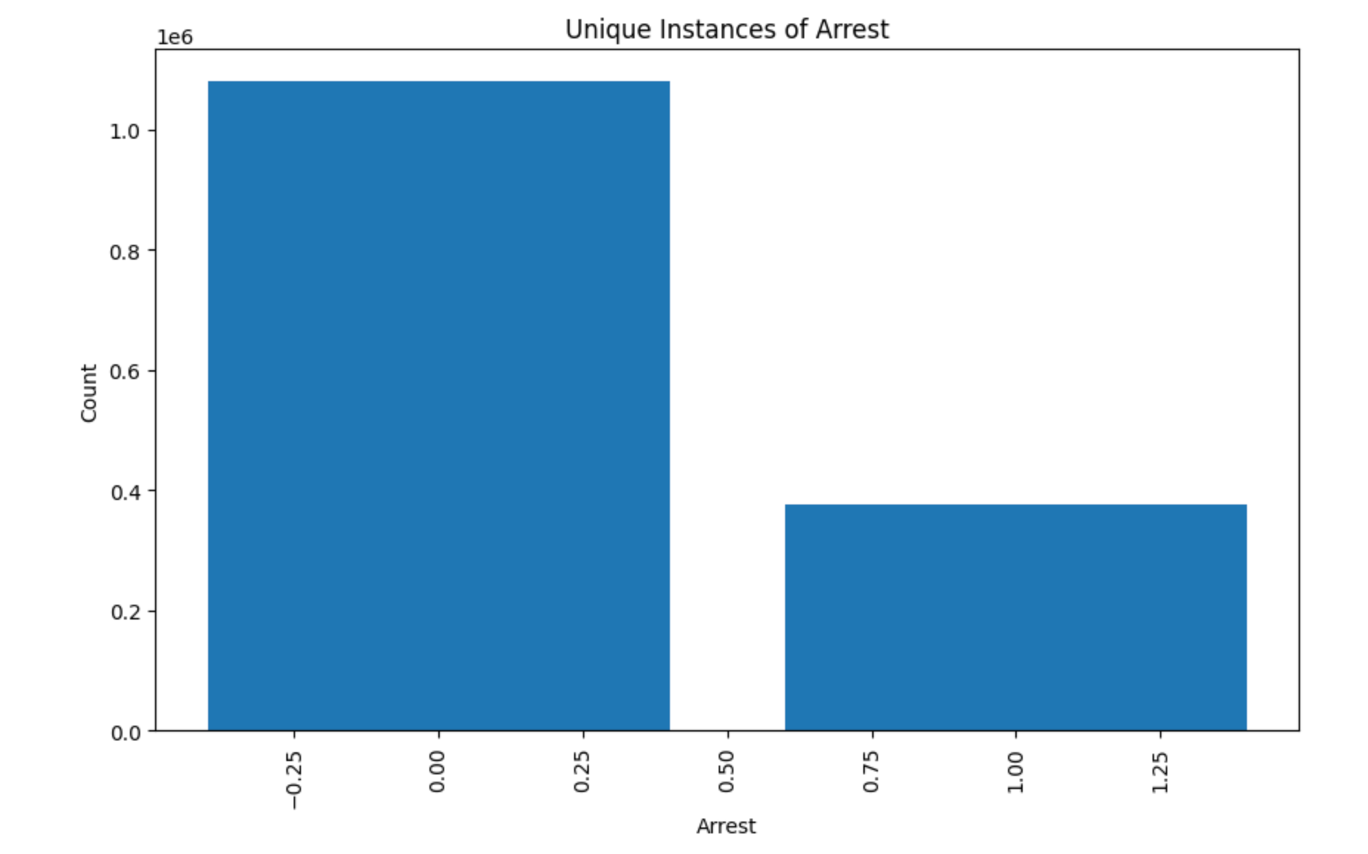
False
(Not arrested)
True
(Arrested)
Notes:
Visualization of the primary type and arrest

Slide 10
Data Preprocessing - Cleaning & Selection
Loaded raw dataset (2012-2017 Chicago crime data)
Checked for missing values
Dropped all rows with any missing values
Still retained 1M+ records
Removed unnecessary features:
Dropped: Unnamed: 0, Case Number, Date, Description, Updated On, Location, Latitude, Longitude
Reason: Redundant identifiers or overly specific info that’s not critical for prediction
Target variable: Arrest (binary classification: True/False)
Predicting whether an arrest was make for a reported crime

Slide 11
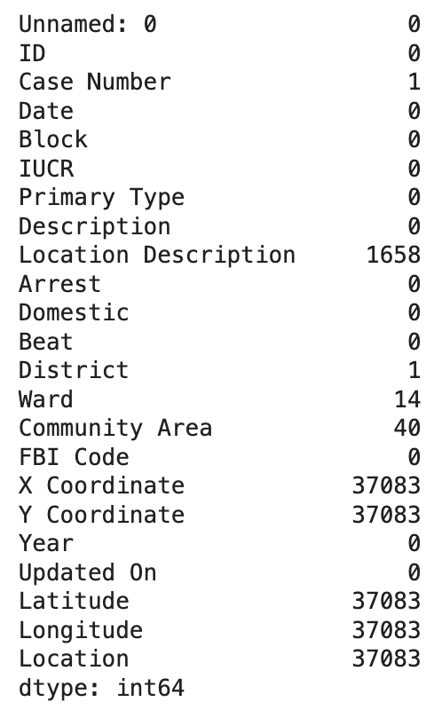
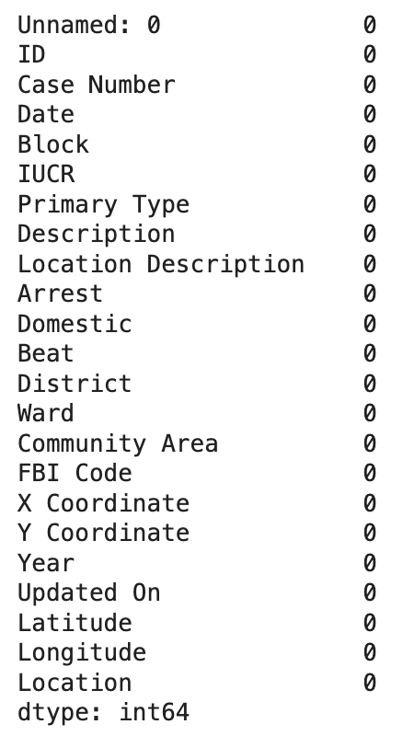
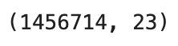
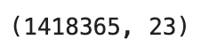
-38349
Notes:
Before and after dealing with missing/null values

Slide 12
Data Preprocessing - Feature Engineering & Encoding
Categorized columns into:
Categorical: Primary Type, Location Description, Domestic
Numerical: IUCR, Ward, District, Beat, Community Area, Year
Dropped unnecessary date/time and location feature for this model
Feature encoding:
Applied one-hot encoding to categorical features
Converted boolean Domestic and Arrest values for modeling
Normalized numerical data using StandardScaler for consistency
Result:
Clean and well structured dataset ready for modeling and regression/classification tasks

Slide 13
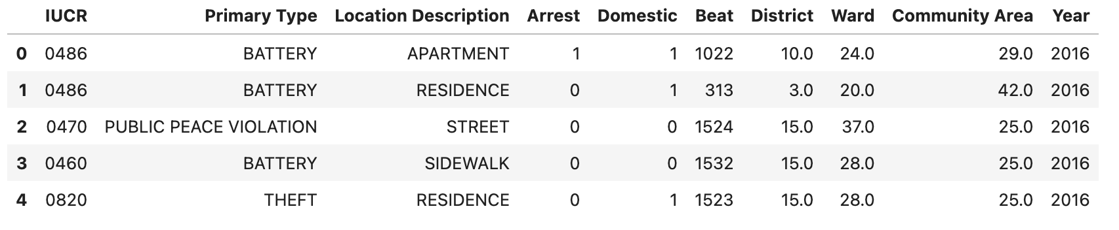
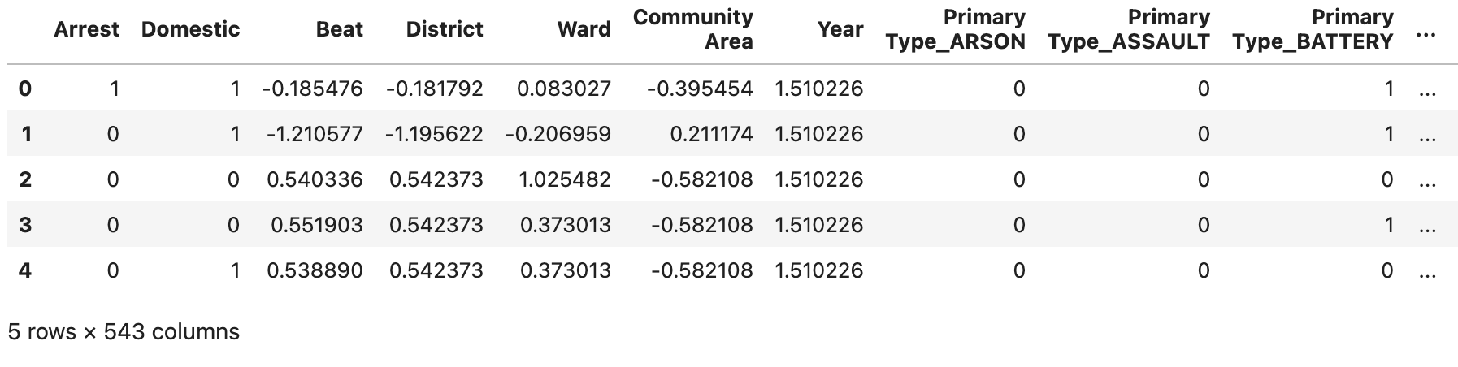
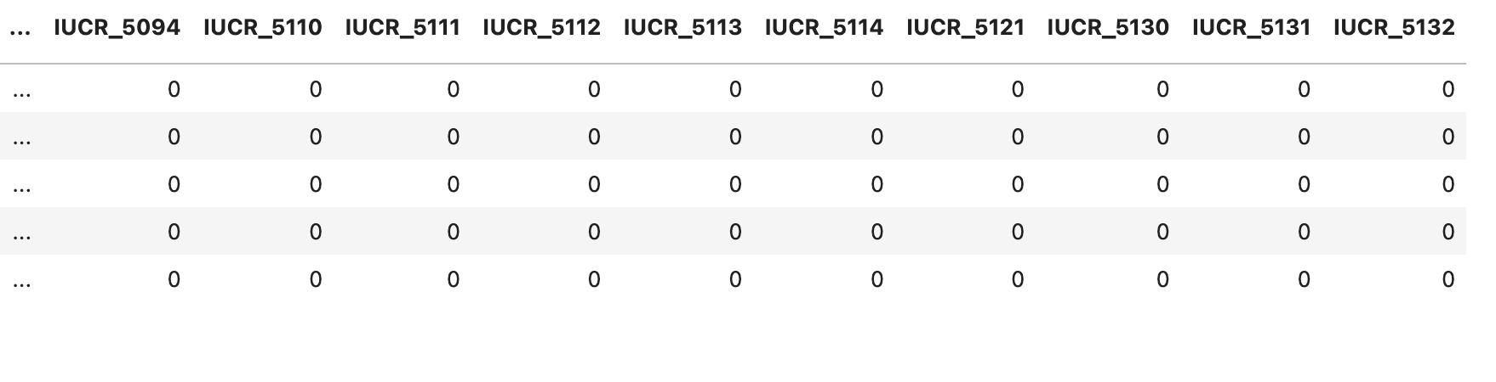
Notes:
Before (after removing missing values/redundant info) and after encoding/standardizing

Slide 14
Baseline model
Data Preparation
Using the cleaned
Split into features (X) and target (y = Arrest)
Applied an 80/20 train-test split
Models trained
Decision Tree Classifier
Trained on full feature set
Evaluated using accuracy
Confusion Matrix
True Positives: Correctly predicted arrests
False Positives: Predicted arrest when none happened
Logistic Regression
Baseline linear classifier for binary target
Set max_iter=1000 to ensure convergence
Evaluated using accuracy, classification report, and confusion matrix

Slide 15
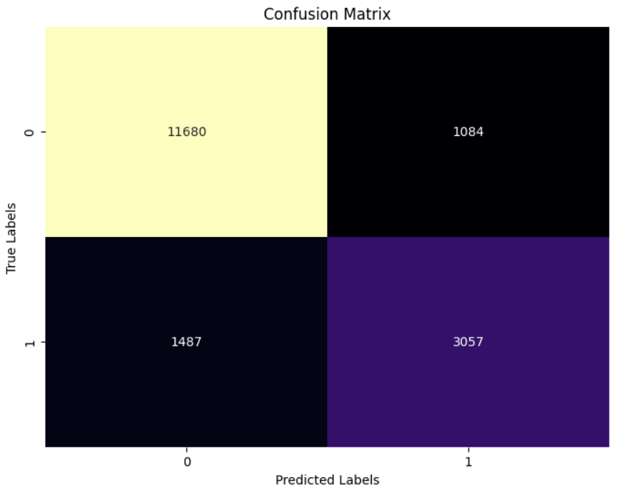
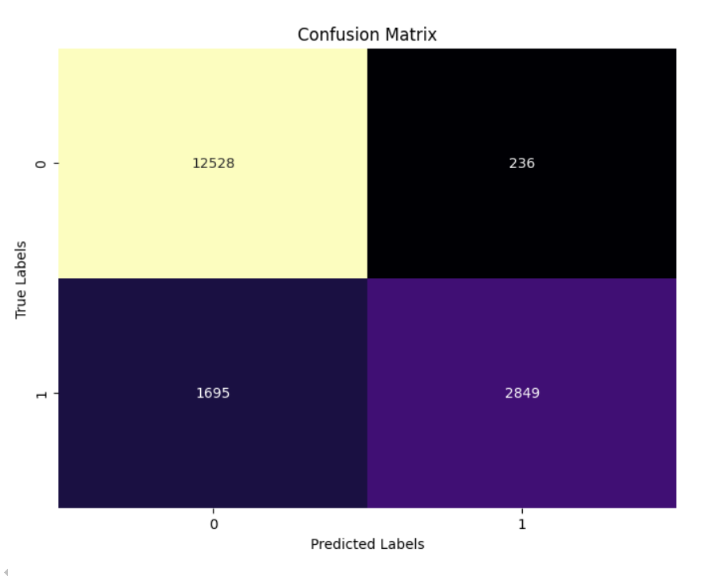
Decision Tree Classifier:
Logistic Regression:
True Negative
(correctly predicted no arrest)
False Positive
(incorrectly predicted arrest)
True Negative
(correctly predicted no arrest)
False Positive
(incorrectly predicted arrest)
True Positive
(correctly predicted an arrest)
False Negative
(missed an arrest)
True Positive
(correctly predicted an arrest)
False Negative
(missed an arrest)
Notes:
Confusion matrix

Slide 16
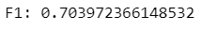
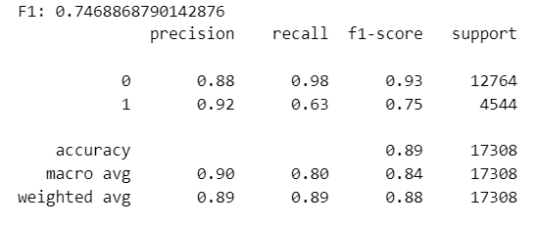
Decision Tree Classifier:
Logistic Regression:
Notes:
Baseline results

Slide 17
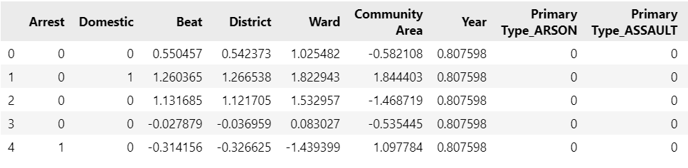
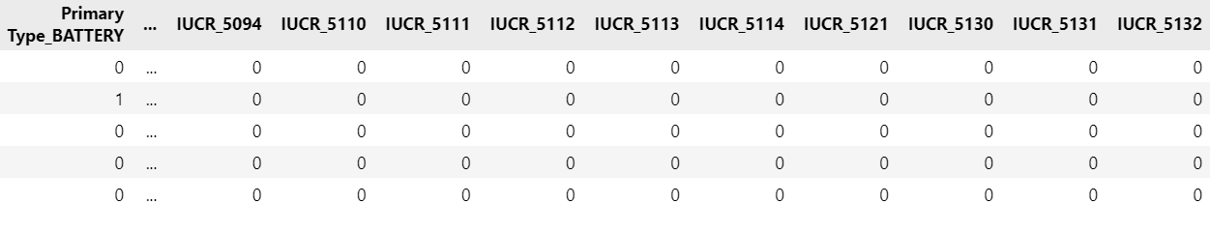
Resized data for 2015

Slide 18
XGBoost Model Summary
Why XGBoost?
Gradient boosting algorithm known for high performance and speed, great for large, imbalanced datasets.
Training Strategy:
Tested on 5,000 and 10,000 randomly sampled rows
Used XGBClassifier with binary logistic objective to predict Arrest
Model Evaluation:
Confusion matrix used to visualize classification results
Improved over baseline and performed competitively with Random Forest

Slide 19
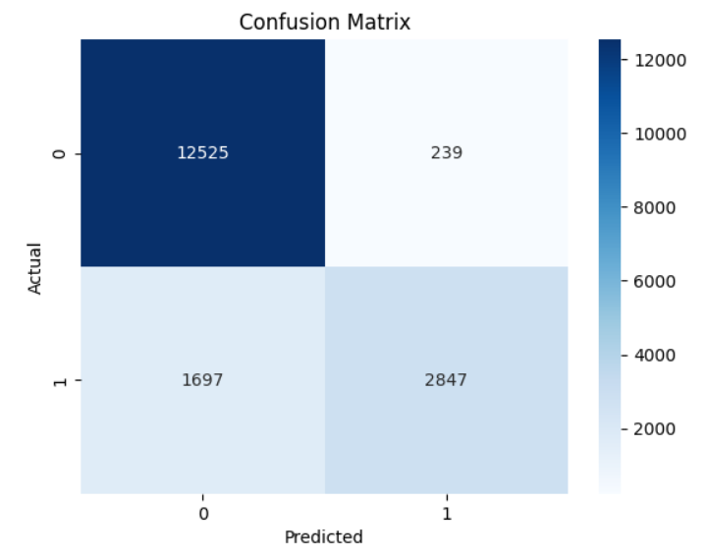
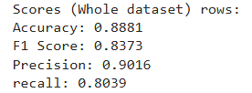
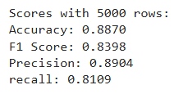
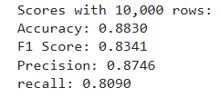
True Negative
(correctly predicted no arrest)
False Positive
(incorrectly predicted arrest)
False Negative
(missed an arrest)
True Positive
(correctly predicted an arrest)
Notes:
Results of the XGBoost model

Slide 20
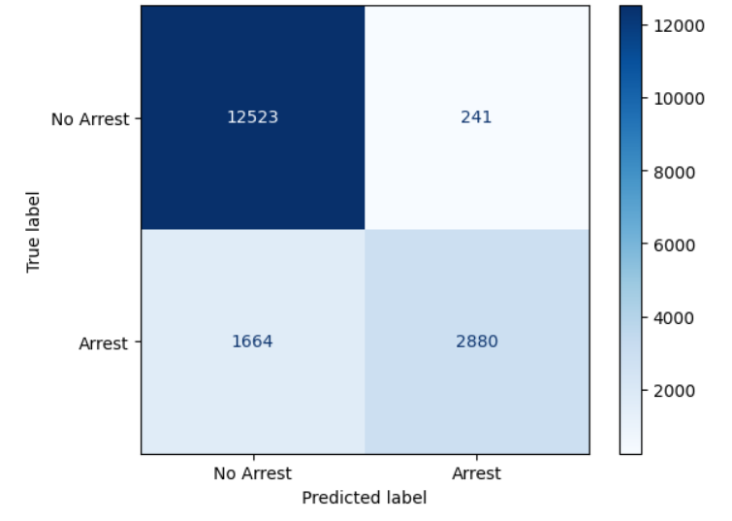
GridSearch XG boosting - after tuning
True Negative
(correctly predicted no arrest)
False Positive
(incorrectly predicted arrest)
False Negative
(missed an arrest)
True Positive
(correctly predicted an arrest)
Notes:
Cross validation/after tuning A low recall score suggest the model is missing some true positive cases.
The model performs the best in precision, so it is usually right when it predicts an arrest

Slide 21
Random Forest Model Summary
Why Random Forest?
A more advanced ensemble model compared to logistic regression, handles large datasets, and class imbalance better.
Training Strategy:
Tested on two sample sizes: 5,000 and 10,000 records for quicker evaluation
Final model trained on reduced dataset (around 80,000 rows)
Confusion Matrix:
Visualized predictions vs. actual arrest outcomes
Helps identify false arrests and missed arrests in prediction
Hyperparameter Grid Search:
Searches over a grid of RF hyperparameters using 3-fold cross-validation to find the combination that gives the best F1 score on the training data set.

Slide 22
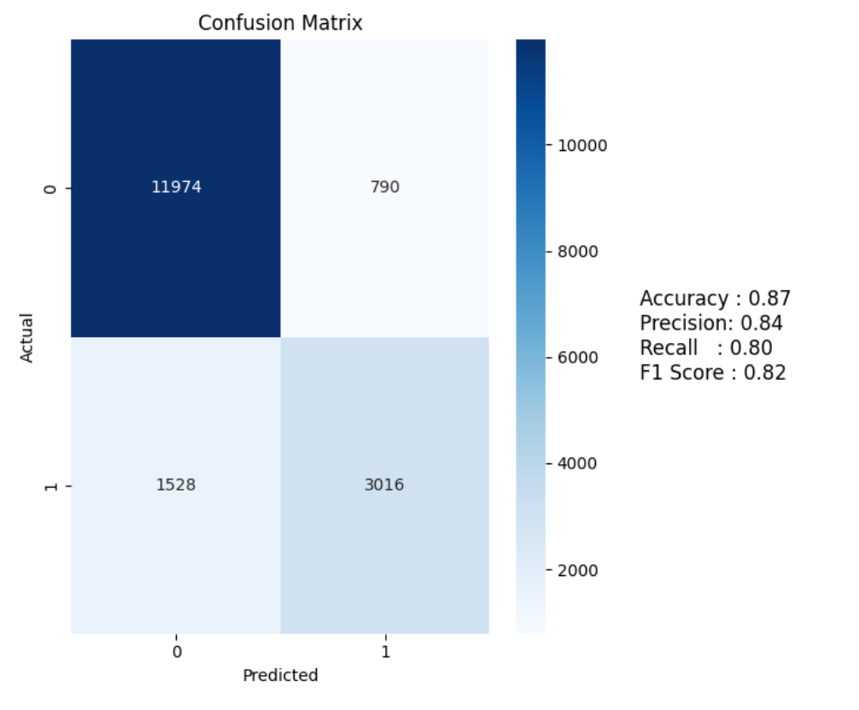
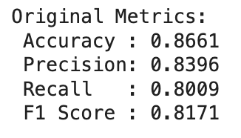
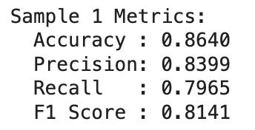
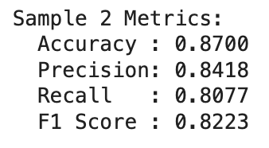
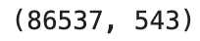
True Negative
(correctly predicted no arrest)
False Positive
(incorrectly predicted arrest)
False Negative
(missed an arrest)
True Positive
(correctly predicted an arrest)
Notes:
Results of the random forest model, and size of dataset tested

Slide 23
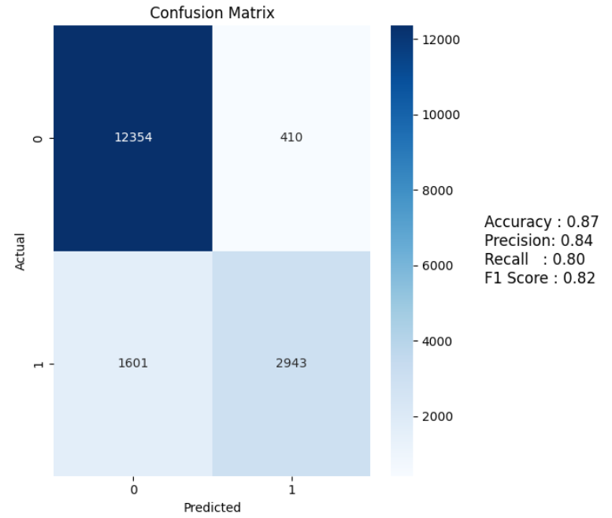
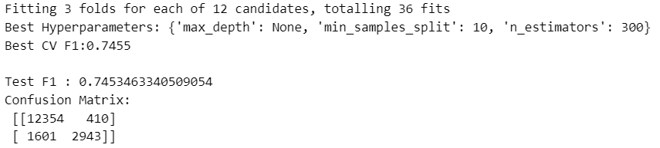
Grid Search Random Forest - after tuning
True Negative
(correctly predicted no arrest)
False Positive
(incorrectly predicted arrest)
False Negative
(missed an arrest)
True Positive
(correctly predicted an arrest)

Slide 24
Logistic Regression Model Summary
Why Logistic Regression?
Simple, interpretable for binary classification. Useful for understanding feature impact.
Training Strategy:
Tested on the whole reduced dataset, 5,000 and 10,000 randomly sampled rows for efficiency.
Used LogisticRegression from scikit-learn to predict likelihood of arrest.
Model Evaluation:
Confusion matrix, F1 score, and classification report used to assess performance.
Showed reasonable F1 score, but limited in handling complex patterns and imbalance.

Slide 25
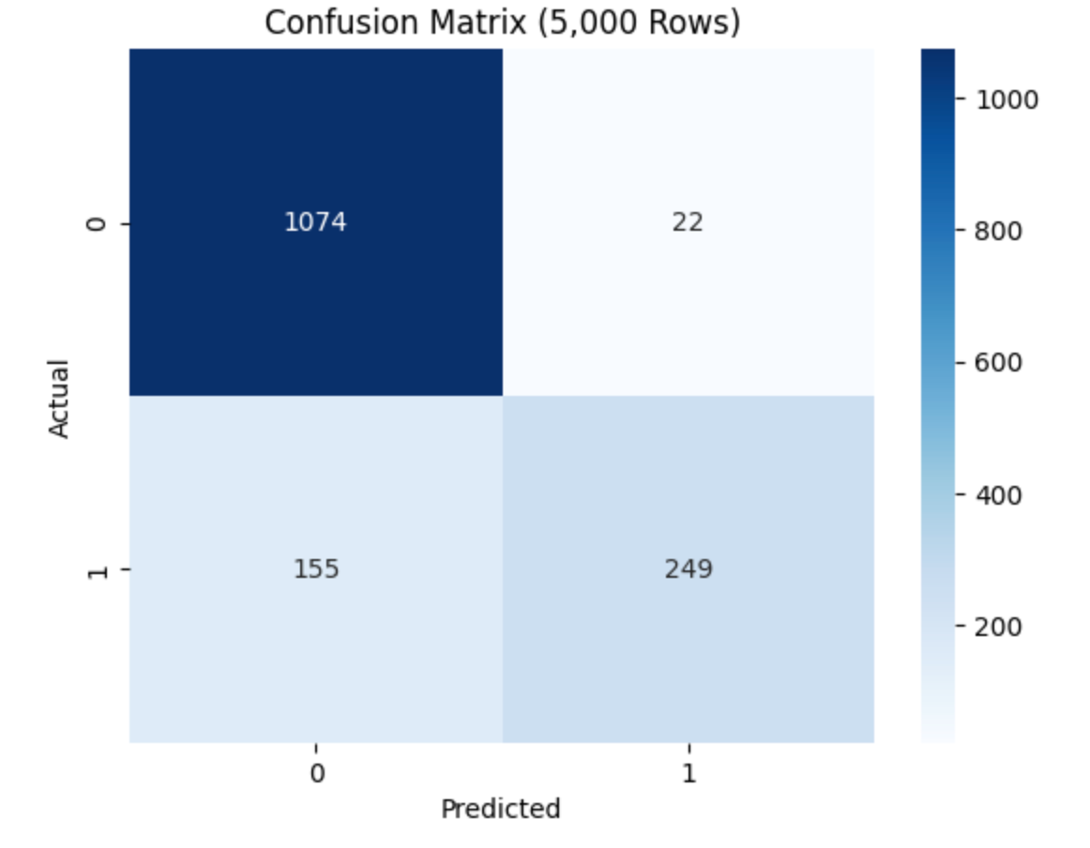
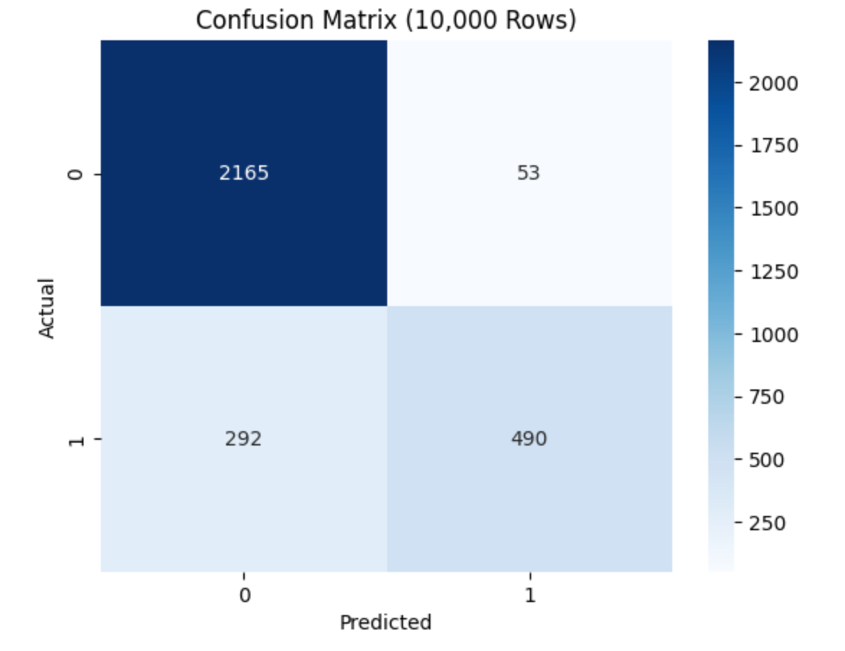
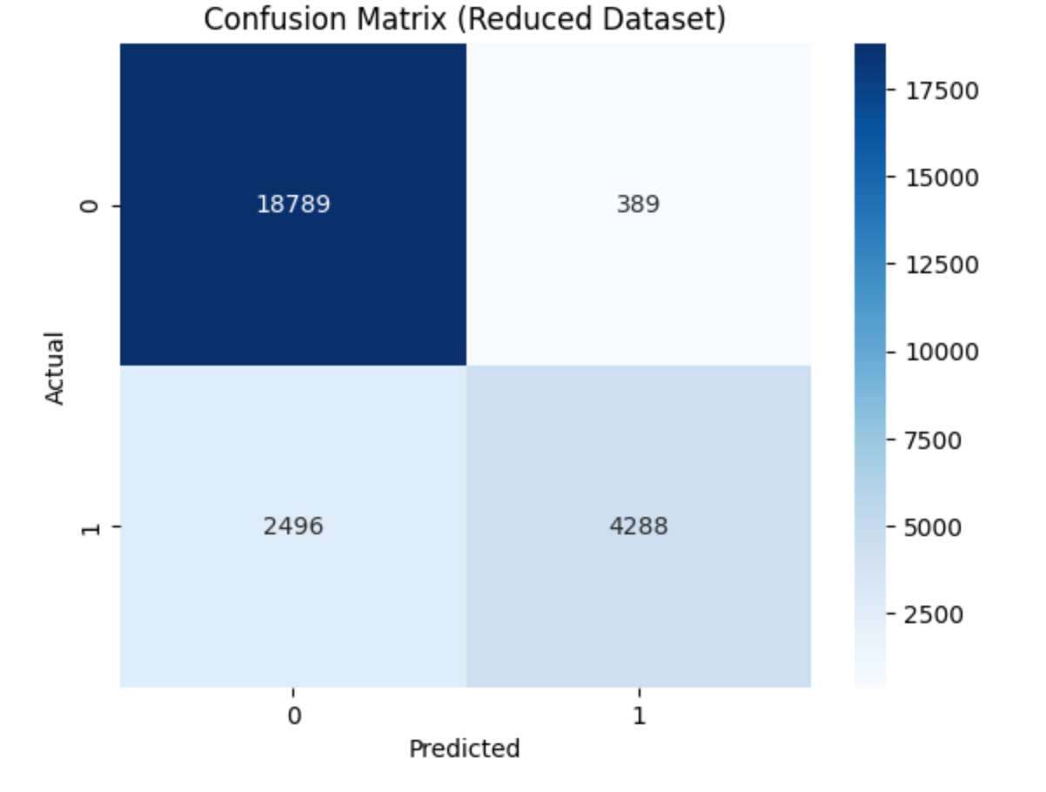
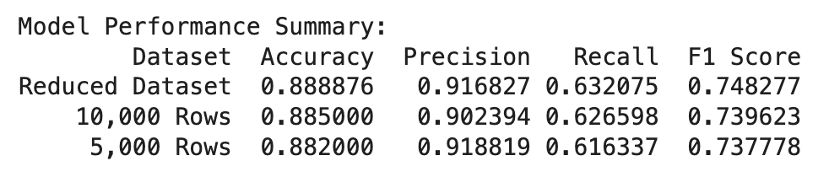
True Negative
(correctly predicted no arrest)
False Positive
(incorrectly predicted arrest)
False Negative
(missed an arrest)
True Positive
(correctly predicted an arrest)
Notes:
Results of the logistic regression model

Slide 26
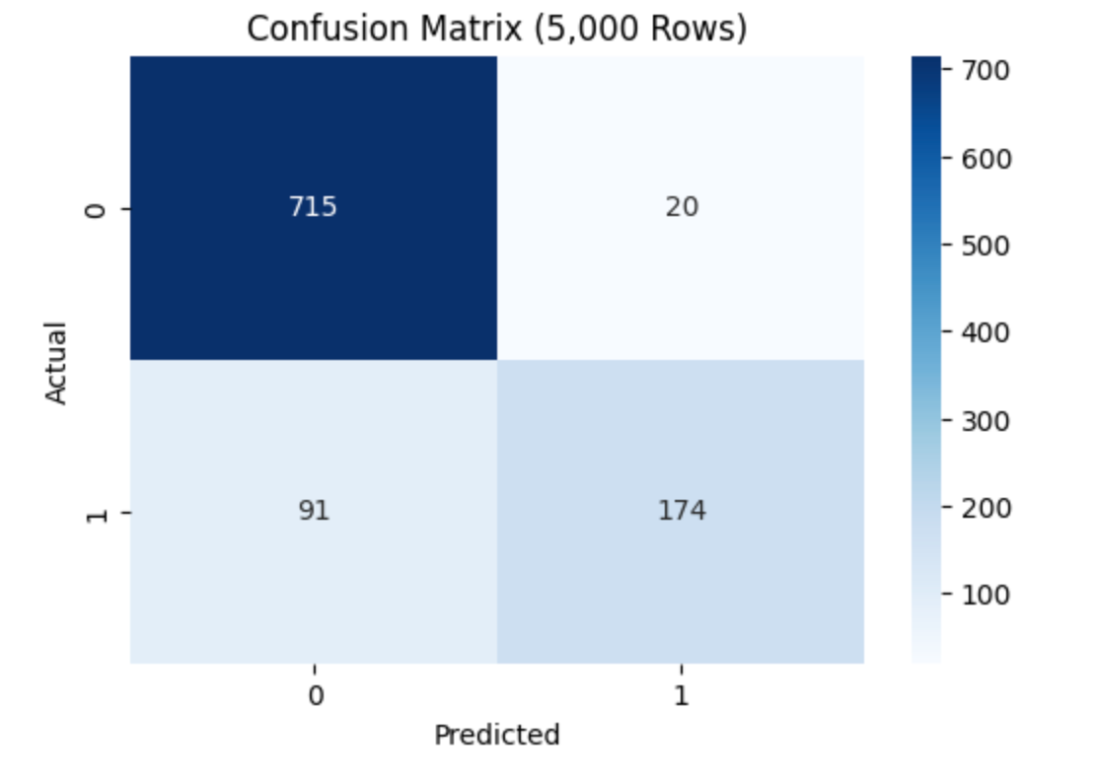
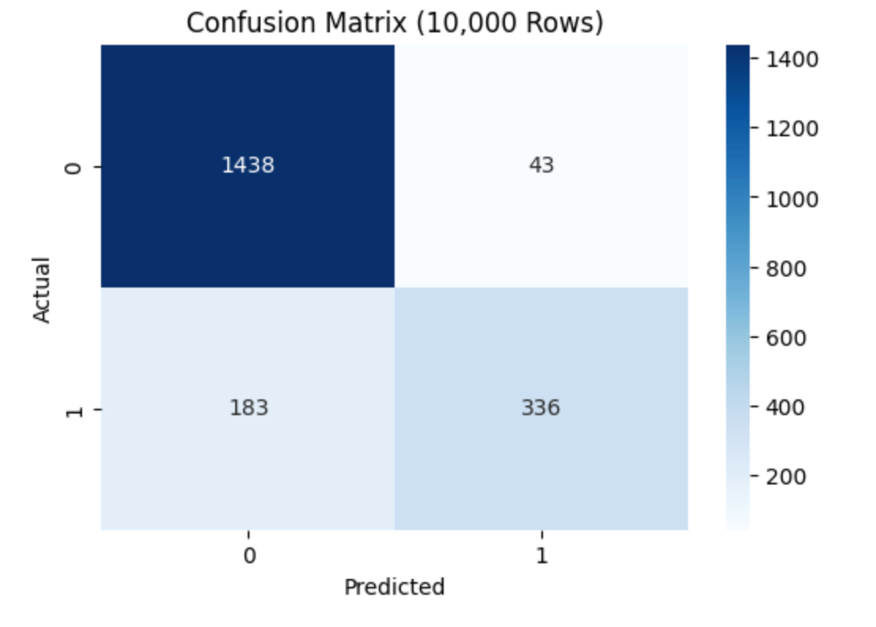

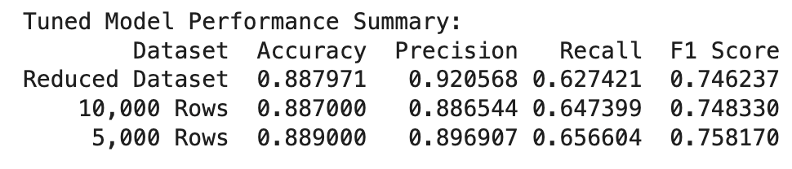
Grid Search Logistic Regression - after tuning
True Negative
(correctly predicted no arrest)
False Positive
(incorrectly predicted arrest)
False Negative
(missed an arrest)
True Positive
(correctly predicted an arrest)
Notes:
After tuning

Slide 27
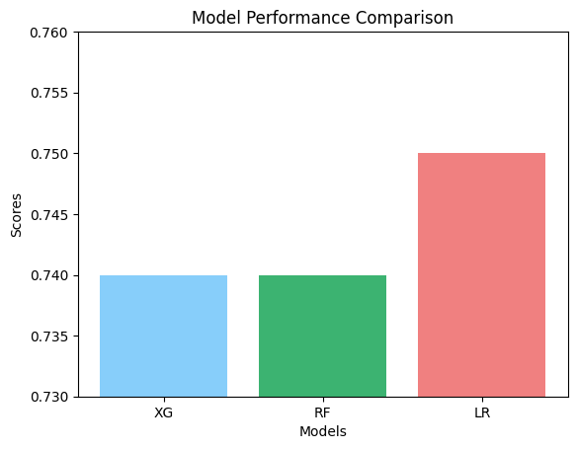
Final Model Selection
Best model: Logistic Regression
Based on: F1 score
Why?
Metric that combines recall & precision

Slide 28
Challenges
Data Quality
Missing values required row dropping
Some features (like location, descriptions) too noisy or inconsistent
Forced to Reduce
Due to its size, we needed to reduce the dataset which affected our overall results
The loss of the data limited how much we were able to thoroughly conclude
Imbalanced Classes
Most crimes did not lead to arrest so we had a skewed target distribution

Slide 29
Limitations & Future Work
What Could Be Improved
Include more recent data (post-2017) for current trends
Add external features: demographic info, police staffing, surveillance
Use feature selection to reduce dimensionality and multicollinearity
Future Modeling Ideas
Try ensemble models, neural networks, or cost sensitive learning
Apply clustering to identify hidden crime/arrest patterns
Explore spatial/temporal modeling for dynamic predictions
Real-World Impact
Help police departments allocate resources more efficiently
Improve transparency on what factors lead to arrests
Inform policy changes to reduce disparities in law enforcement

Slide 30
Questions? Comments?
Thank you!

